Slide 1

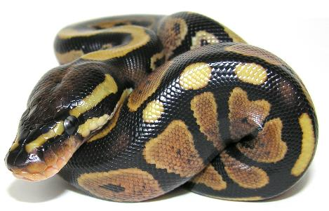
CHEME 5500 Software Carpentry
Python – A Crash Course
Searching

Slide 2
Searching
Finding the index of a value/object in a list
In a list, where is the maximum?
In a list, where is the minimum?
In a list, where are all the negative numbers?
Two main ideas:
Linear
Binary

Slide 3
Linear Searching
Let’s find the smallest number larger than 20 in this list
Check if N > 20
Check if N < N_{prev}
∞
331
21
-3
123
84
34
0
-23
75
2
0
1
2
3
4
5
6
7
8
9
20

Slide 4
Linear Searching
Let’s find the smallest number larger than 20 in this list
Check if N > 20 yes
Check if N < N_{prev} yes
331
331
21
-3
123
84
34
0
-23
75
2
0
0
1
2
3
4
5
6
7
8
9
20

Slide 5
Linear Searching
Let’s find the smallest number larger than 20 in this list
Check if N > 20 yes
Check if N < N_{prev} yes
331
331
21
-3
123
84
34
0
-23
75
2
0
0
1
2
3
4
5
6
7
8
9
20

Slide 6
Linear Searching
Let’s find the smallest number larger than 20 in this list
Check if N > 20 yes
Check if N < N_{prev} yes
21
331
21
-3
123
84
34
0
-23
75
2
1
0
1
2
3
4
5
6
7
8
9
20

Slide 7
Linear Searching
Let’s find the smallest number larger than 20 in this list
Check if N > 20 no
Check if N < N_{prev} yes
21
331
21
-3
123
84
34
0
-23
75
2
1
0
1
2
3
4
5
6
7
8
9
20

Slide 8
Linear Searching
Let’s find the smallest number larger than 20 in this list
Check if N > 20 yes
Check if N < N_{prev} no
21
331
21
-3
123
84
34
0
-23
75
2
1
0
1
2
3
4
5
6
7
8
9
20

Slide 9
Linear Searching
Let’s find the smallest number larger than 20 in this list
Check if N > 20 yes
Check if N < N_{prev} no
21
331
21
-3
123
84
34
0
-23
75
2
1
0
1
2
3
4
5
6
7
8
9
20

Slide 10
Linear Searching
Let’s find the smallest number larger than 20 in this list
Check if N > 20 yes
Check if N < N_{prev} no
21
331
21
-3
123
84
34
0
-23
75
2
1
0
1
2
3
4
5
6
7
8
9
20

Slide 11
Linear Searching
Let’s find the smallest number larger than 20 in this list
Check if N > 20 no
Check if N < N_{prev} yes
21
331
21
-3
123
84
34
0
-23
75
2
1
0
1
2
3
4
5
6
7
8
9
20

Slide 12
Linear Searching
Let’s find the smallest number larger than 20 in this list
Check if N > 20 no
Check if N < N_{prev} yes
21
331
21
-3
123
84
34
0
-23
75
2
1
0
1
2
3
4
5
6
7
8
9
20

Slide 13
Linear Searching
Let’s find the smallest number larger than 20 in this list
Check if N > 20 yes
Check if N < N_{prev} no
21
331
21
-3
123
84
34
0
-23
75
2
1
0
1
2
3
4
5
6
7
8
9
20

Slide 14
Linear Searching
Let’s find the smallest number larger than 20 in this list
Check if N > 20 no
Check if N < N_{prev} yes
21
331
21
-3
123
84
34
0
-23
75
2
1
0
1
2
3
4
5
6
7
8
9
DONE
20

Slide 15
Binary Searching
Requires a sorted binary tree
331
21
-3
123
84
34
0
-23
75
2
0
1
2
3
4
5
6
7
8
9

Slide 16
Binary Searching
Requires a sorted binary tree
Check if N > 20
Check if N < N_{prev}
21
1
0
75
6
8
-23
2
34
123
7
9
5
3
-3
84
331
2
4
0

Slide 17
Binary Searching
Requires a sorted binary tree
Check if N > 20 yes
Check if N < N_{prev} yes
21
1
0
75
6
8
-23
2
34
123
7
9
5
3
-3
84
331
2
4
0
∞
20

Slide 18
Binary Searching
Requires a sorted binary tree
Check if N > 20 yes
Check if N < N_{prev} yes
21
1
0
75
6
8
-23
2
34
123
7
9
5
3
-3
84
331
2
4
0
21
20
1

Slide 19
Binary Searching
Requires a sorted binary tree
Check if N > 20 no
Check if N < N_{prev} yes
21
1
0
75
6
8
-23
2
34
123
7
9
5
3
-3
84
331
2
4
0
21
20
1

Slide 20
Binary Searching
Requires a sorted binary tree
Check if N > 20 no
Check if N < N_{prev} yes
DONE
21
1
0
75
6
8
-23
2
34
123
7
9
5
3
-3
84
331
2
4
0
21
20
1

Slide 21
Comparing the two
Linear took 20 comparisons to find the smallest number larger than 20
Binary took 6!
Should we only ever use binary?
What situations is linear better in?

Slide 22
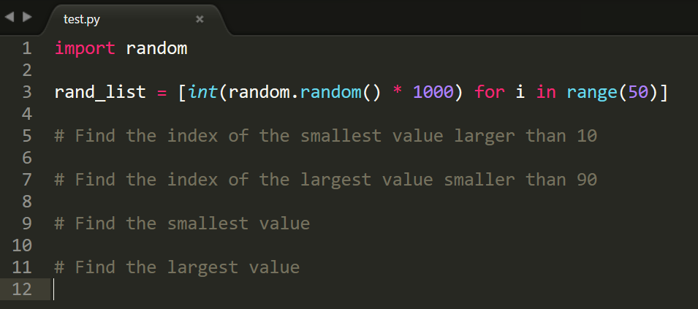
PRACTICE
In python, fill in the following code:

Slide 23
CHEME 5500 Software Carpentry
Python – A Crash Course
Esoteric Sections
Optimization

Slide 24
Optimization
Optimization allows us to find the best values for a given situation
Think of fitting curves to data points
Useful in computational research, as well as data analysis for experimental work
Typically bundled together in software packages

Slide 25
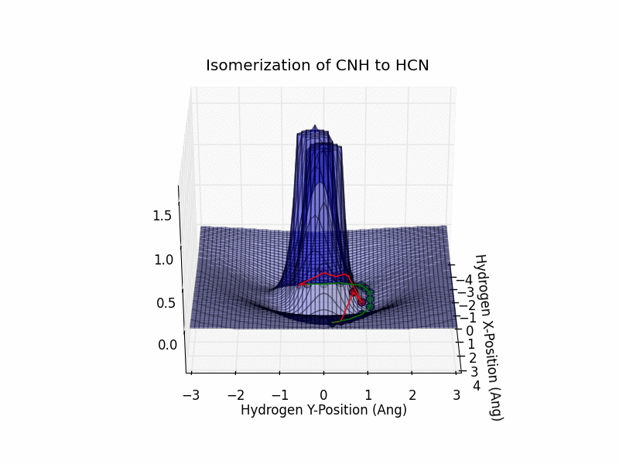
Example of Optimization

Slide 26
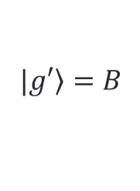
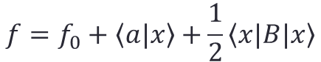
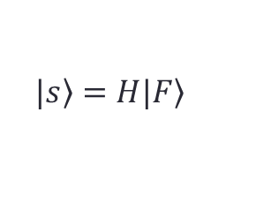
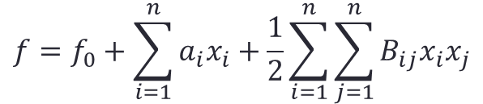
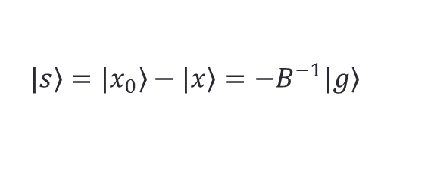
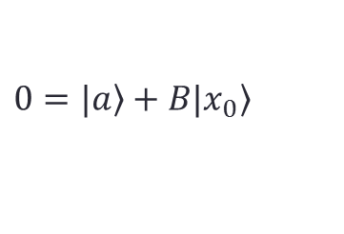
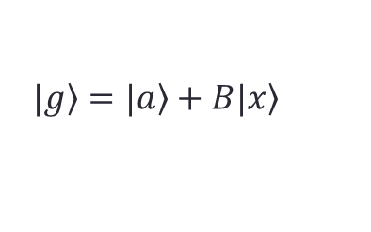
The Quasi-Newton Method
$$f=f_{0}+\sum_{i=1}^{n}{a_{i}x_{i}}+\frac{1}{2}\sum_{i=1}^{n}{\sum_{j=1}^{n}{B_{ij}x_{i}x_{j}}}$$
$$f=f_{0}+\left\langle a\right.|\left.x\right\rangle +\frac{1}{2}\left\langle x\right.|B\left.|x\right\rangle$$
$$|\left.g\right\rangle =|\left.a\right\rangle +B\left.|x\right\rangle$$
$$|\left.g′\right\rangle =B$$
$$0=|\left.a\right\rangle +B\left.|x_{0}\right\rangle$$
$$|\left.s\right\rangle =|\left.x_{0}\right\rangle −|\left.x\right\rangle =−B^{−1}|\left.g\right\rangle$$
$$|\left.s\right\rangle =H|\left.F\right\rangle$$
Notation:
B = Hessian
H = Inverse Hessian

Slide 27
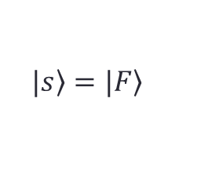
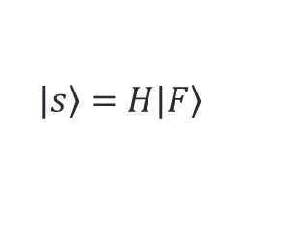
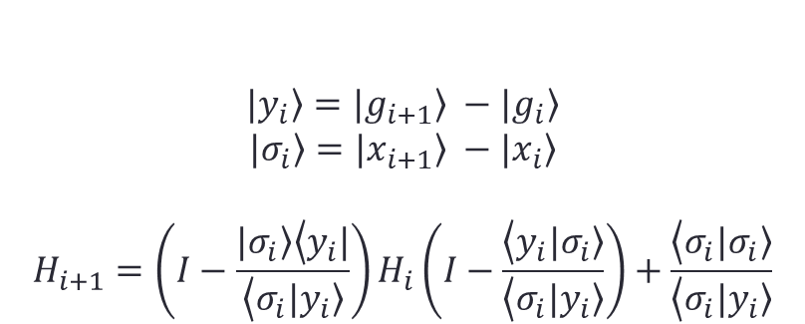
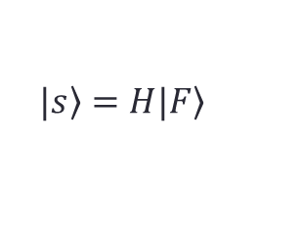
Some Methods
Quasi-Newton Method:
Steepest Descent:
Broyden-Fletcher-Goldfarb-Shanno (BFGS):
$$|\left.s\right\rangle =H|\left.F\right\rangle$$
$$|\left.s\right\rangle =|\left.F\right\rangle$$
$$|\left.s\right\rangle =H|\left.F\right\rangle$$
$$|\left.y_{i}\right\rangle =|\left.g_{i+1}\right\rangle −|\left.g_{i}\right\rangle$$
$$|\left.σ_{i}\right\rangle =|\left.x_{i+1}\right\rangle −|\left.x_{i}\right\rangle$$
$$H_{i+1}=\left(I−\frac{|\left.σ_{i}\right\rangle \left\langle y_{i}\right.|}{\left\langle σ_{i}\right.|\left.y_{i}\right\rangle }\right)H_{i}\left(I−\frac{\left\langle y_{i}\right.|\left.σ_{i}\right\rangle }{\left\langle σ_{i}\right.|\left.y_{i}\right\rangle }\right)+\frac{\left\langle σ_{i}\right.|\left.σ_{i}\right\rangle }{\left\langle σ_{i}\right.|\left.y_{i}\right\rangle }$$

Slide 28
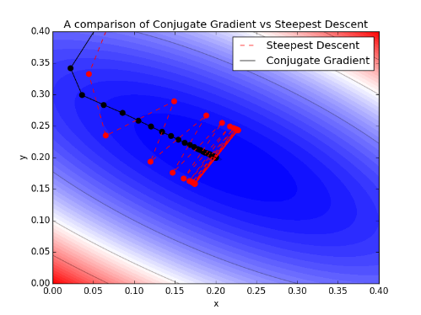
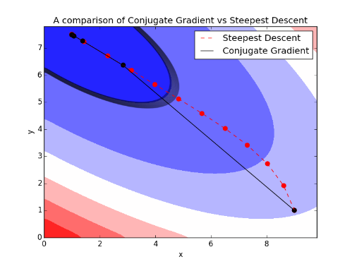
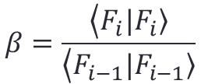
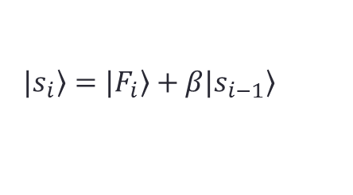
Conjugate Gradient
Conjugate Gradient:
$$|\left.s_{i}\right\rangle =|\left.F_{i}\right\rangle +β|\left.s_{i−1}\right\rangle$$
$$β=\frac{\left\langle F_{i}\right.|\left.F_{i}\right\rangle }{\left\langle F_{i−1}\right.|\left.F_{i−1}\right\rangle }$$
Fletcher-Reeves Method

Slide 29
Steepest Descent
Let’s write some code!

